Slide 1
Some Recent Results on the Covering Numbers of Symmetric Groups, and Sporadic Groups
Luise-Charlotte Kappe
Daniela Nikolova-Popova
Eric Swartz
Ischia 2016

Slide 2
Abstract
We say that a group G has a finite covering if G is a set theoretical union of finitely many proper subgroups. The minimal number of subgroups needed for such a covering is called the covering number of G denoted by ϭ(G).
Let S_{n} be the symmetric group on n letters. For odd n Maroti determined ϭ(S_{n})= 2^{n-1} with the exception of n = 9, and gave estimates for n even showing that ϭ(S_{n}) ≤ 2^{n-2}. Using GAP calculations, as well as incidence matrices and linear programming, we show that ϭ(S₈) = 64, ϭ(S₁₀) = 221, ϭ(S₁₂) = 761. We also show that Maroti ’s result for odd n holds without exception proving that ϭ(S₉)=256.
We establish in addition that ϭ(A9)=157, ϭ(A11)=2751, the Mathieu group m₁₂ has covering number 208, and improve the estimate for the Janko group J₁ given by P.E. Holmes.

Slide 3
The Covering Number
Theorem 1 (Tomkinson,1997): Let G be a finite soluble group and let p^{α} be the order of the smallest chief factor having more that one complement. Then σ(G) = p^{α} +1.
The author suggested the investigation of the covering number of simple groups.

Slide 4
Linear Groups
Theorem 2 (Bryce, Fedri, Serena, 1999)
σ(G)=1/2 q(q+1) when q is even,
σ(G)=1/2 q(q+1)+1 when q is odd,
where G=PSL(2,q), PGL(2,q), or GL(2,q),
and q ≠ 2, 5, 7, 9.

Slide 5
Suzuki Groups
Theorem 3 (Lucido, 2001)
σ(Sz(q)) = ½ q²(q²+1),
where q = 2^{2m+1}.

Slide 6
Sporadic Simple Groups
Theorem 6 (P.E. Holmes, 2006)
σ(m₁₁)=23, σ(m₂₂)= 771, σ(m₂₃)=41079,
σ(Ly) = 112845655268156,
σ(O’N) = 36450855
5165 ≤ σ(J₁) ≤ 5415
24541 ≤ σ(McL) ≤ 24553.
The author has used GAP, the ATLAS, and Graph Theory.

Slide 7
Symmetric and Alternating Groups
Theorem 4 (Maroti, 2005)
σ(S_{n}) = 2^{n-1} if n is odd, n ≠ 9
σ(S_{n}) ≤ 2^{n-2} if n is even.
σ(A_{n})≥ 2^{n-2} if n ≠7,9, and σ(A_{n})= 2^{n-2} if n is even but not divisible by 4.
σ(A₇) ≤ 31, and σ(A₉) ≥ 80.

Slide 8
^{Alternating Groups}
Theorem 5 (Luise-Charlotte Kappe, Joanne Redden, 2009)
σ(A₇)= 31
σ(A₈) = 71
127 ≤ σ(A₉) ≤ 157
σ(A₁₀) = 256.

Slide 9
Recent results
We can now prove the exact numbers:
σ(S8) = 64.
σ(S9) = 256.
σ(S10)=221.
σ(S12)=761.
σ(A9) = 157.
σ(A11) = 2751.
5316 ≤σ(J1) ≤ 5413.

Slide 10
Starting point
It is sufficient to consider the number of maximal subgroups of G needed to cover all maximal cyclic subgroups of G.
We used GAP for the distribution of the elements in the maximal subgroups
We first estimated the limits by a Greedy Algorithm.

Slide 11
Note:
Easy case: When the elements are partitioned into the subgroups of a conjugacy class.
Harder case: When the elements of a certain cyclic structure are not partitioned.
Further Approaches:
Incidence matrices and Combinatorics
Linear programming

Slide 12
S7
Maximal subgroups | Order of Class Representative | Size
MS1 = A_7 | 2520 | 1
MS2 = S_6 | 720 | 7
MS3 = S_3 x S_4 | 144 | 35
MS4 = C_2 x S_5 | 240 | 21
MS5 = (C_7:C_3):C_2 | 42 | 120

Slide 13
Distribution of the Elements of S7:
Order | Cyclic Structure | Size | MS1=A_7 | MS2 | MS3 | MS4 | MS5
1 | 1 | 1 | 1
2 | (12) | 21 | 0 | 15 | 9 | 11 | 0
2 | (12)(34) |  | X
2 | (12)(34)(56) | 105 | 0 | 15,P | 9 | 15 | 7
3 | (123) |  | X
3 | (123)(456) |  | X
4 | (1234) | 210 | 0 | 90 | 6,P | 30 | 0
4 | (1234)(56) |  | X
5 | (12345) |  | X
6 | (123456) | 840 | 0 | 120,P | 0 | 0 | 14
6 | (123)(45) | 420 | 0 | 120 | 36 | 40 | 0
6 | (123)(45)(67) |  | X
7 | (1234567) | 720 | X
10 | (12345)(67) | 504 | 0 | 0 | 0 | 24,P | 0
12 | (1234)(567) | 420 | 0 | 0 | 12,P | 0 | 0

Slide 14
S7
It is clear from the table why σ= 2⁷⁻¹
The group is covered by A₇ (MS1), the 7 groups S₆ in MS2, the 35 groups in MS3, and the 21 groups in MS4: 1+7+35+21=64=2⁶.
σ(S7) = 64.

Slide 15
S8
Maximal subgroups | Order of Class Representative | Size
MS1 = A_8 | 20160 | 1
MS2 = S_3 x S_5 | 720 | 56
MS3 = C_2 x S_6 | 1440 | 28
MS4 = S_7 | 5040 | 8
MS5=((((C_2xD_8):C_2):C_3):C_2):C_2 | 384 | 105
MS6 = (S_4 x S_4): C_2 | 1152 | 35
MS7 = PSL(3,2): C_2 | 336 | 120

Slide 16
S8
Distribution of Elements:
Order | Cyclic Structure | Size | MS1 | MS2 | MS3 | MS4 | MS5 | MS6 | MS7
1 | 1 | 1 | 1 | 1 | 1 | 1 | 1 | 1 | 1
2 | 2¹ | 28 | 0 | 13(26) | 16(16) | 21(6) | 4(15) | 12(15) | 0
2 | 2² | 210 | 210, P | 45(12) | 60(8) | 105(4) | 18(9) | 42(7) | 0
2 | 2³ | 420 | 0 | 45(6) | 60(4) | 105(2) | 28(7) | 36(3) | 28(8)
2 | 2⁴ | 105 | 105, P | 0 | 15(4) | 0 | 25(25) | 33(11) | 21(24)
3 | 3¹ | 112 | 112, P | 22(11) | 40(10) | 70(5) | 0 | 16(5) | 0
4 | 2x4 | 2520 | 2520,P | 90(2) | 180(2) | 630(2) | 24,P | 72,P | 0
4 | 4¹ | 420 | 0 | 30(4) | 90(6) | 210(4) | 12(3) | 12,P | 0
4 | 2²x 4 | 1260 | 0 | 0 | 90(2) | 0 | 36(3) | 180(5) | 0
4 | 4² | 1260 | 1260,P | 0 | 0 | 0 | 60(5) | 108(3) | 42(4)
5 | 5 | 1344 | 1344,P | 24,P | 144(3) | 504(3) | 0 | 0 | 0
6 | 2x3 | 1120 | 0 | 100(5) | 160(4) | 420(3) | 0 | 96(3) | 0
6 | 2x2x3 | 1680 | 1680,P | 90(3) | 120(2) | 210,P | 0 | 48,P | 0
6 | 2x3² | 1120 | 0 | 40(2) | 40,P | 0 | 32(3) | 0 | 0
6 | 6 | 3360 | 0 | 0 | 120,P | 840(2) | 32,P | 0 | 56(2)
6 | 2 x 6 | 3360 | 3360,P | 0 | 120,P | 0 | 32,P | 192(2) | 0
7 | 7 | 5760 | 5760,P | 0 | 0 | 720,P | 0 | 0 | 48,P
8 | 8 | 5040 | 0 | 0 | 0 | 0 | 48,P | 144,P | 84(2)
10 | 2 x 5 | 4032 | 0 | 72,P | 144,P | 504,P | 0 | 0 | 0
12 | 3 x 4 | 3360 | 0 | 60,P | 0 | 420,P | 0 | 96,P | 0
15 | 3 x 5 | 2688 | 2688,P | 48,P | 0 | 0 | 0 | 0 | 0

Slide 17
S8
Here are the maximal subgroups and the distribution of the elements of S₈ in the representatives of the maximal subgroups. In parentheses the small numbers mean in how many representatives each element is to be found.
Example: Each element of order 6 of type 2x3 i.e. (1,2)(3,4,5) is to be found in 3 representatives of MS4, and in each representative of MS4 there are 420 such elements.
The group is covered by A₈ (MS1), the 28 groups in MS3, and the 35 groups in MS6, i.e. 1+28+35 = 64 = 2⁶.
σ(S8) = 64.
The difficulty consists to prove that this is a minimal covering.
We first did that computationally using GAP and Gurobi optimizer.Now, we have a paper proof as well.

Slide 18
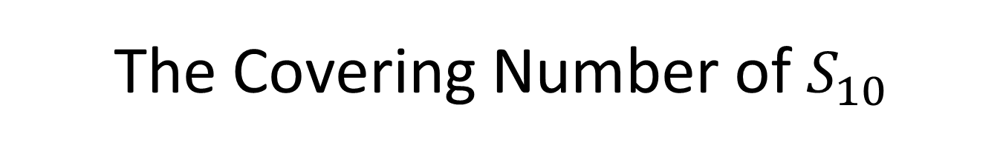
The Covering Number of $S_{10}$
To determine a minimal covering by maximal subgroups, it suffices to find a minimal covering of the conjugacy classes of maximal cyclic subgroups by maximal subgroups of the group.

Slide 19
Maximal subgroups
Maximal subgroups (3977) | Order of Class Representative | Size
MS1 = A_10 | 1814400 | 1
MS2=S_4 x S_6 | 17280 | 210
MS3 = S_3 x S_7 | 30240 | 120
MS4 = C_2 x S_8 | 80640 | 45
MS5 = S_9 | 362880 | 10
MS6= C_2 x (((C_2xC_2xC_2xC_2):A_5):C_2 | 3840 | 945
MS7 = (S_5 x S_5):C_2 | 28800 | 126
MS8 = (A_6.C_2):C_2 | 1440 | 2520

Slide 20
Distribution of elements generating maximal cyclic subgroups:
Order | Cyclic Structure | Size | MS1 | MS2 | MS3 | MS4 | MS5 | MS6 | MS7 | MS8
ODD
4 | 2²x 4 | 56700 | 0 | 1080₄ | 1890₄ | 3780₃ | 11340₂ | 180₃ | 900₂ | 0
4 | 2x4² | 56700 | 0 | 540₂ | 0 | 1260,P | 0 | 300₅ | 1800₄ | 90₄
6 | 2³x3 | 25200 | 0 | 480₄ | 840₄ | 1680₃ | 2520, P | 0 | 600₃ | 0
6 | 2x3² | 50400 | 0 | 1200₅ | 1680₄ | 2240₂ | 10080₂ | 160₃ | 800₂ | 0
6 | 2²x6 | 75600 | 0 | 360,P | 0 | 3360₂ | 0 | 240₃ | 2400₄ | 0
6 | 3x6 | 201600 | 0 | 960,P | 1680,P | 0 | 20160,P | 0 | 0 | 240₃
8 | 8 | 226800 | 0 | 0 | 0 | 5040,P | 45360 | 240,P | 0 | 180
10 | 10 | 362880 | 0 | 0 | 0 | 0 | 0 | 384,P | 2880,P | 144,P
12 | 3²4 | 50400 | 0 | 240,P | 840₂ | 0 | 0 | 160₃ | 0 | 0
14 | 2x7 | 259200 | 0 | 0 | 2160,P | 5760,P | 25920,P | 0 | 0 | 0
20 | 4x5 | 181440 | 0 | 964,P | 0 | 0 | 18144,P | 0 | 1440,P | 0
30 | 2x3x5 | 120960 | 0 | 0 | 1008,P | 2688,P | 0 | 0 | 960,P | 0
-EVEN------ | ---------- | --------- | -------- | --------- | -------- | --------- | --------- | ------- | -------- | ------
6 | 2 x 6 | 151200 | P | 720, P | 2520₂ | 6720₂ | 30240₂ | 160 P | 0 | 0
9 | 9 | 403200 | P | 0 | 0 | 0 | 40320, P | 0 | 0 | 0
12 | 4x6 | 151200 | P | 720, P | 0 | 0 | 0 | 160, P | 2400_{x2} | 0
12 | 2x3x4 | 151200 | P | 1440₂ | 2520₂ | 3360 P | 15120 P | 0 | 1200 P | 0
21 | 3 x 7 | 172800 | P | 0 | 1440 P | 0 | 0 | 0 | 0 | 0
8 | 8x2 | 226800 | P | 0 | 0 | 5040,P | 0 | 240,P | 3600₂ | 180₂

Slide 21
S10
We first found that the Covering number has upper bound: MS1+MS3+MS5+MS7 =1+120+10+126=257.
However, we ran a Greedy algorithm on MS3 and found out that 84 groups only from MS3 are sufficient to cover the elements of type 3²x4. So:
σ ≤ 1+84+10+126=221.
The upper bound was reduced.
The lower bound: The elements of type 3² x 4 are 50400. If they were partitioned in MS3 we would have needed 50400/840 = 60.
So, we need at least 61 from them.
1+61+10+126= 198.
Hence 198 ≤ σ ≤221.

Slide 22
Theorem 1:
The Covering Number of S10 is 221.
Sketch of the Proof:
It is not difficult to see from the Inventory that the groups from MS3, MS5, and MS7 represent a covering of the odd permutations, and MS1={A10} covers the even.
We want to minimize this covering.
The problematic elements are of structure 3x3x4, of order 12.
The proof further involves Incidence matrices, and Combinatorics.

Slide 23
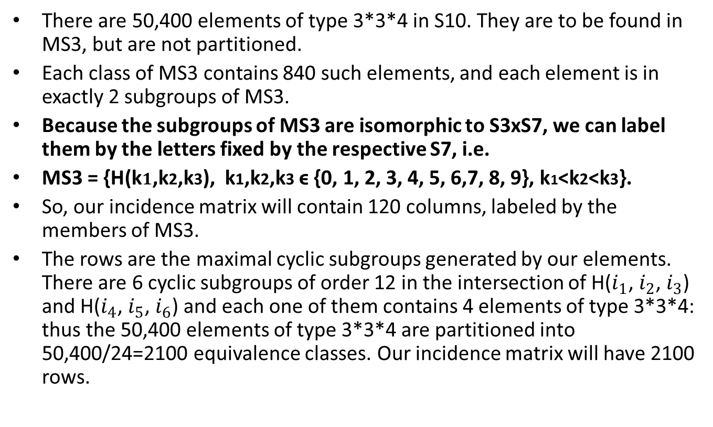
The elements of type 3*3*4
There are 50,400 elements of type 3*3*4 in S10. They are to be found in MS3, but are not partitioned.
Each class of MS3 contains 840 such elements, and each element is in exactly 2 subgroups of MS3.
Because the subgroups of MS3 are isomorphic to S3xS7, we can label them by the letters fixed by the respective S7, i.e.
MS3 = {H(k$1$,k2,k3), k1,k2,k3 ϵ {0, 1, 2, 3, 4, 5, 6,7, 8, 9}, k1<k2<k3}.
So, our incidence matrix will contain 120 columns, labeled by the members of MS3.
The rows are the maximal cyclic subgroups generated by our elements. There are 6 cyclic subgroups of order 12 in the intersection of H($i_{1}$, $i_{2}$, $i_{3}$) and H($i_{4}$, $i_{5}$, $i_{6}$) and each one of them contains 4 elements of type 3*3*4: thus the 50,400 elements of type 3*3*4 are partitioned into 50,400/24=2100 equivalence classes. Our incidence matrix will have 2100 rows.

Slide 24
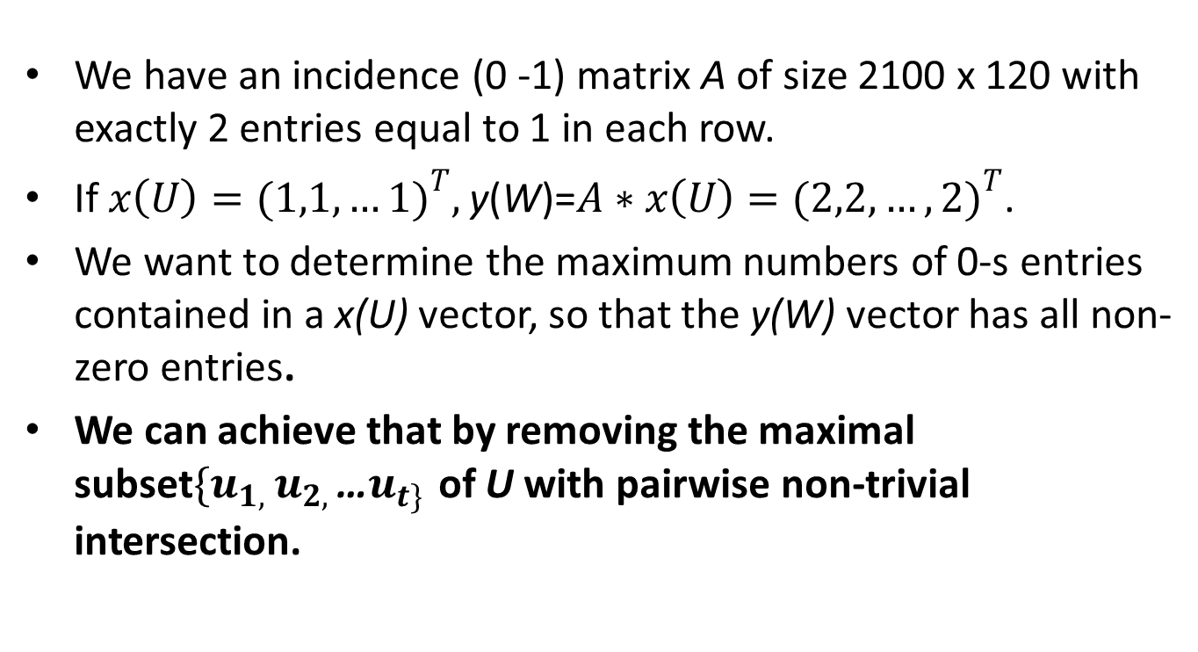
Confirming the result of the Greedy algorithm
We have an incidence (0 -1) matrix A of size 2100 x 120 with exactly 2 entries equal to 1 in each row.
If $x\left(U\right)={(1,1,…1)}^{T},$y(W)=$A∗x\left(U\right)={(2,2,…,2)}^{T}$.
We want to determine the maximum numbers of 0-s entries contained in a x(U) vector, so that the y(W) vector has all non-zero entries.
We can achieve that by removing the maximal subset$\{u_{1, }u_{2, }$…$u_{t\} }$of U with pairwise non-trivial intersection.

Slide 25
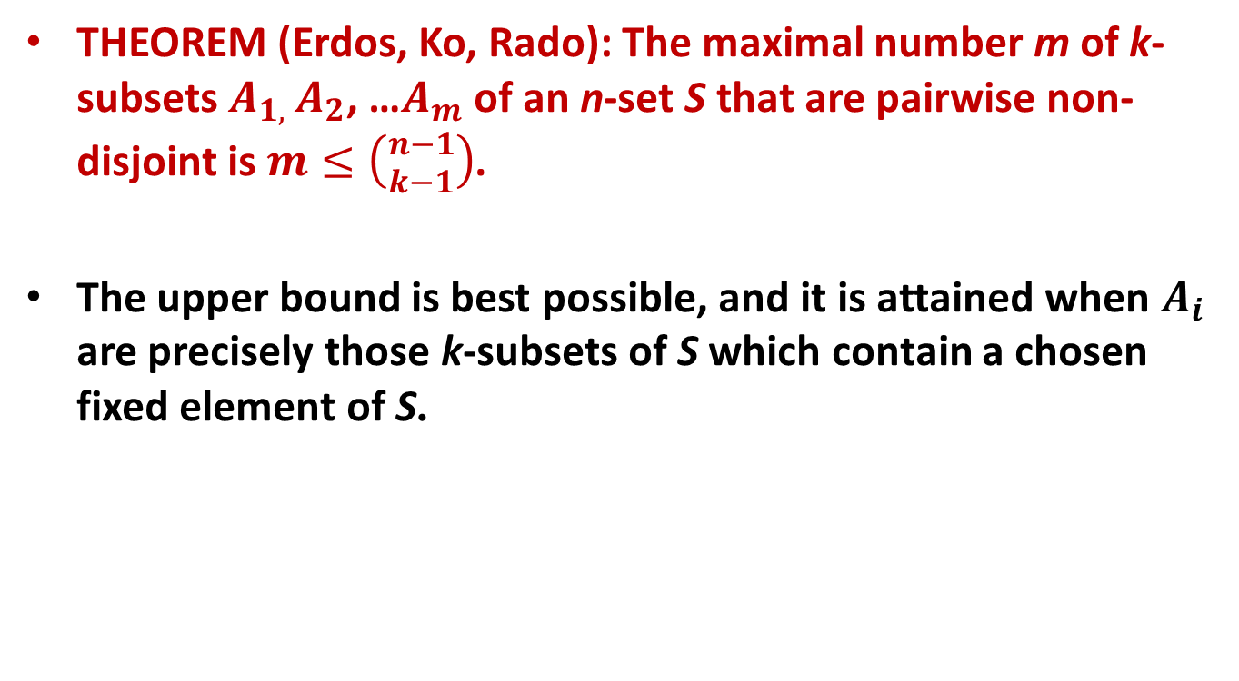
Combinatorics
THEOREM (Erdos, Ko, Rado): The maximal number m of k-subsets $A_{1, }A_{2}$, …$A_{m}$ of an n-set S that are pairwise non-disjoint is $m≤\left({n−1 \atop k−1}\right)$.
The upper bound is best possible, and it is attained when $A_{i}$ are precisely those k-subsets of S which contain a chosen fixed element of S.

Slide 26
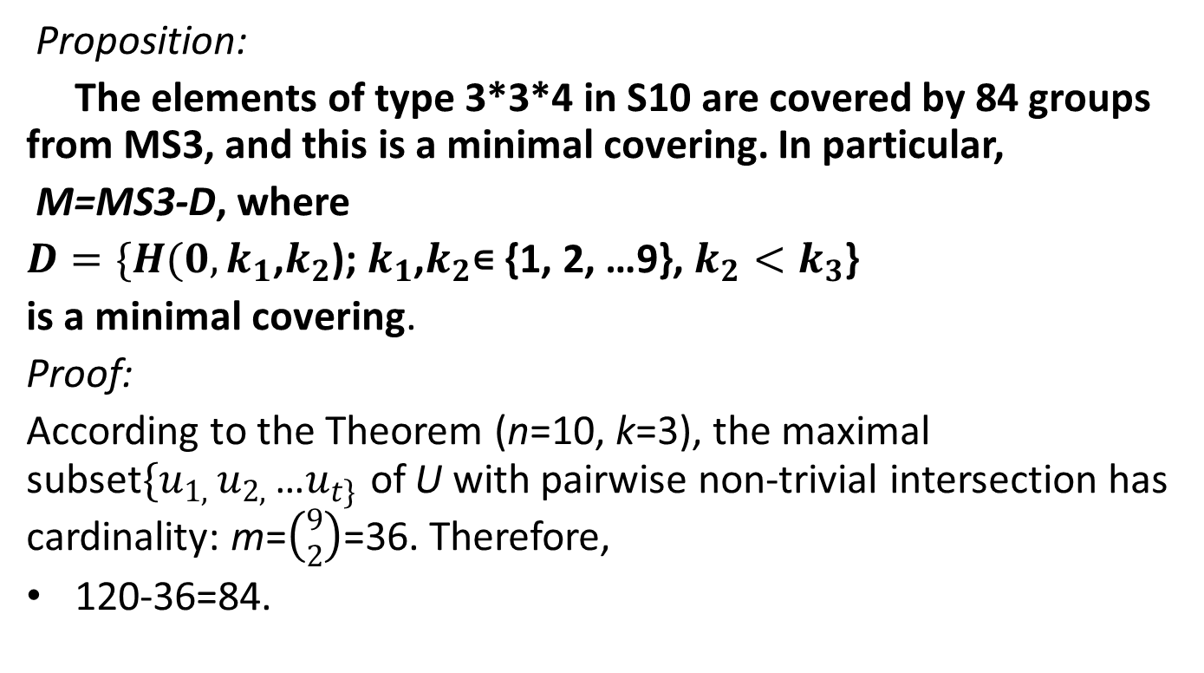
Corollary
Proposition:
The elements of type 3*3*4 in S10 are covered by 84 groups from MS3, and this is a minimal covering. In particular,
M=MS3-D, where
$D=\{H(0, k_{1}$,$k_{2}$); $k_{1}$,$k_{2}$∊ {1, 2, …9}, $k_{2}<k_{3}$}
is a minimal covering.
Proof:
According to the Theorem (n=10, k=3), the maximal subset$\{u_{1, }u_{2, }$…$u_{t\} }$of U with pairwise non-trivial intersection has cardinality: m=$\left({9 \atop 2}\right)$=36. Therefore,
120-36=84.

Slide 27
Proof of Theorem 1
We shall see that ϭ(S₁₀) = |MS1|+|MS5|+|MS7|+84= 221 .
The elements of order 21 are only to be found in MS1 and MS3, in both they are partitioned, so we take MS1={A10}, size 1.
The elements of order 10 are partitioned in MS6, MS7, and MS8. MS7 has the least size: 126.
The elements of order 14, type 2*7 are partitioned in MS3, and MS5. If H(0,k1,k2) is removed from MS3, they will no longer be covered by MS3. They can only be covered by all 10 members of MS5.
Together with the result for the elements of type 3*3*4, we have:
ϭ(S₁₀)= 1+ 126+ 10+ 84 = 221.

Slide 28
S9
Maximal subgroups (1376) | Order of Class Representative | Size
MS1 = A_9 | 181440 | 1
MS2 = S_4 x S_5 | 2880 | 126
MS3 = S_3 x S_6 | 4320 | 84
MS4 = C_2 x S_7 | 10080 | 36
MS5= S_8 | 40320 | 9
MS6 = ((((C_3x((C_3xC_3):C_2)):C_2):C_3):C_2):C_2 | 1296 | 280
MS7 = (((C_3xC_3):Q_8):C_3):C_2 | 432 | 840

Slide 29
S9
Distribution of Elements:
Order | Cyclic Structure | Size | MS1 | MS2 | MS3 | MS4 | MS5 | MS6 | MS7
1 | 1 | 1 | 1 | 1 | 1 | 1 | 1 | 1 | 1
2 | 2¹ |  | 0
2 | 2²
2 | 2³ |  | 0
2 | 2⁴
3 | 3¹
3 | 3²
3 | 3³
4 | 2x4 | 7560 | 7560,P
4 | 4¹ | 756 | 0 | 36(6) | 90(10) | 210(10) | 420(5) | 0 | 0
4 | 2²x 4 | 11340 | 0 | 180(2) | 270(2) | 630(2) | 1260,P | 162(4) | 0
4 | 4²_{=8^2}
5 | 5 | 3024 | 3024,P
6 | 2x3 | 2520 | 0 | 220(11) | 270(9) | 490(7) | 1120(4) | 36(4) | 0
6 | 2²x3 | 7560 | 7560,P
6 | 2x3² | 10080 | 0 | 160(2) | 360(3) | 280,P | 1120,P | 36, P | 0
6 | 6 | 10080 | 0 | 0 | 120,P | 840(3) | 3360(3) | 36, P | 56(2)
6 | 2 x 6 | 30240 | 30240,P
6 | 2³3 | 2520 | 0 | 60(3) | 30, P | 210(3) | 0 | 36(4) | 0
6 | 3x6 | 20160 | 0 | 0 | 240,P | 0 | 0 | 288(4) | 72(3)
7 | 7 | 25920 | 25920,P
8 | 8 | 45360 | 0 | 0 | 0 | 0 | 5040,P | 0 | 108(2)
9 | 9 | 40320 | 40320,P
10 | 2 x 5 | 18144 | 0 | 144,P | 432(2) | 1008(2) | 4032(2) | 0 | 0
10 | 2²5 | 9072 | 9072,P
12 | 3 x 4 | 15120 | 0 | 360 | 180,P | 420,P | 3360 | 0 | 0
14 | 2x7 | 25920 | 0 | 0 | 0 | 720,P | 0 | 0 | 0
15 | 3 x 5 | 24192 | 24192,P
20 | 4x5 | 18144 | 0 | 144,P | 0 | 0 | 0 | 0 | 0

Slide 30
S9
Here is the distribution of the elements of S₉ in the representatives of the maximal subgroups. Here is how the lower and the upper bound are clearly to be seen:
We definitely need:
MS1=A_9 (1 group)
MS2 (126 groups) to cover the elements of order 20.
MS4 (36 groups) to cover the elements of order 14, and 12.
MS5 (9 groups) to cover the elements of order 8, and ((1,2,3)(4,5,6)(7,8).
Then, if you take all the 84 groups of MS3, we’ll cover 3 types of elements of order 6. So, 84 more groups add up to 256: the upper bound.
The lower bound.:
If we cover the elements of type 3x6 (20160) by groups from MS6 instead (where they are not partitioned), we would have needed at least 20160/288=70 groups. So, 1+126+36+9+71=243 ≥ σ
Hence, 243 ≤ σ ≤ 256.

Slide 31
Linear Programming
Theorem:The covering number ϭ(S₉) = 256.
Proposition: The elements 3x6 have a minimal covering by 84 subgroups.
Proof: GAP and Gurobi.
Same approach was used for the Mathieu group M12 and the Janko group J1.

Slide 32
J1 and KoKo
The paper can be found at: http://arxiv.org/abs/1409.2292
However, we wanted to achieve the best possible (the smallest) range for J1 on more powerful machines. Which we did on the new super computer KoKo installed by Max Plank at the FAU Harbor branch. Here below are some characteristics of KoKo:
400 Intel Xeon Cores; 1000’s of Intel Xeon Phi Cores; 128GB of RAM per node; Scientific Linux 6.5; 160 terabites memory. For more details see: http://hpc.fau.edu

Slide 33
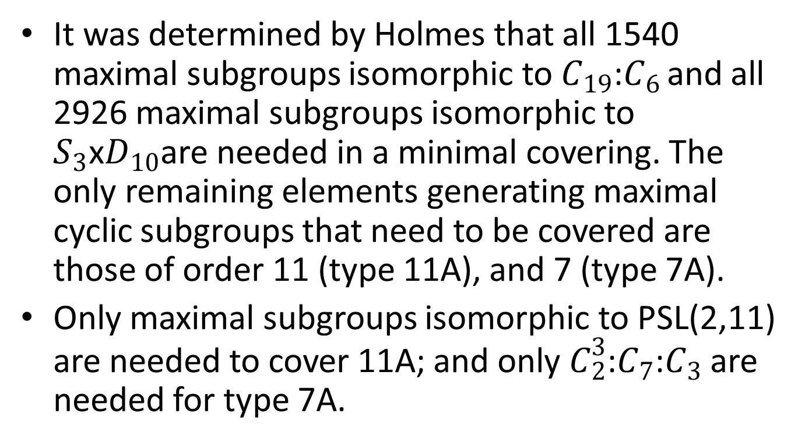
J1
It was determined by Holmes that all 1540 maximal subgroups isomorphic to $C_{19}$:$C_{6 }$and all 2926 maximal subgroups isomorphic to $S_{3}$x$D_{10}$are needed in a minimal covering. The only remaining elements generating maximal cyclic subgroups that need to be covered are those of order 11 (type 11A), and 7 (type 7A).
Only maximal subgroups isomorphic to PSL(2,11) are needed to cover 11A; and only $C_{2}^{3}$:$C_{7}$:$C_{3}$ are needed for type 7A.

Slide 34
GAP and GUROBI
GAP is used to create a system of linear inequalities, the optimal solution to which corresponds to a minimal cover.
GUROBI then performs a linear optimization on this system of linear inequalities.
Any time the “best objective” (best actual solution) and the “best bound”(the size of the best lower bound) found by GUROBI get identical, GUROBI has found a minimal subgroup cover.
The codes can be found at:
http://www.math.Binghamton.edu/menger/coverings/.

Slide 35
J1 and KoKo_2
The program for the elements of order 11 finished in about 2 1/2 hour. It took 196 subgroups to cover the elements of order 11 in J1.
However, although powerful parallel computing was done on the super-computer, with optimal parameters, and using 8 nodes, it took a while to get to:
41146230 38175957 99% 0% 0% 751.00000 650.36569 13.4% 618 581650s (Jan 23);
253860990 231372205 99% 0% 0% 752.00000 653.04421 13.2% 476 2244640s (March 10).
Interpretation: The lower bound we got for the elements of order 7 is 654, the upper bound – 751, and the discrepancy between the two numbers is 13.2%.
It took such a long time, because we deal with a difficult system of equations to optimize. Another reason is that GUROBI optimizer does not have check points, so every time KoKo was stopped for maintenance, we had to restart the program. The last calculation took 476 2244640s = 26.3 days…
With the newest results, we can claim now that the covering number for J1 is between:
1540+2926+196+654=5316 and
1540+2926+196+751=5413, i.e.:
5316 ≤ σ( J₁) ≤ 5413
We also tried MINION, but the problem has no better solution than the one GUROBI provided. This is as far as we can push the bounds for J1 with current techniques.

Slide 36
Thank you!
QUESTIONS?

